Slide 1

Bad Bot Threat Analytics: Geographic, ISP & Use Case Intelligence Dashboard
NANDHINI N
This data analysis focuses on evaluating customer behavior and bot traffic patterns across multiple dimensions using the provided dataset. The objective of this report is to identify trends, assess risks, and provide actionable insights to enhance network performance and threat mitigation strategies.

Slide 2
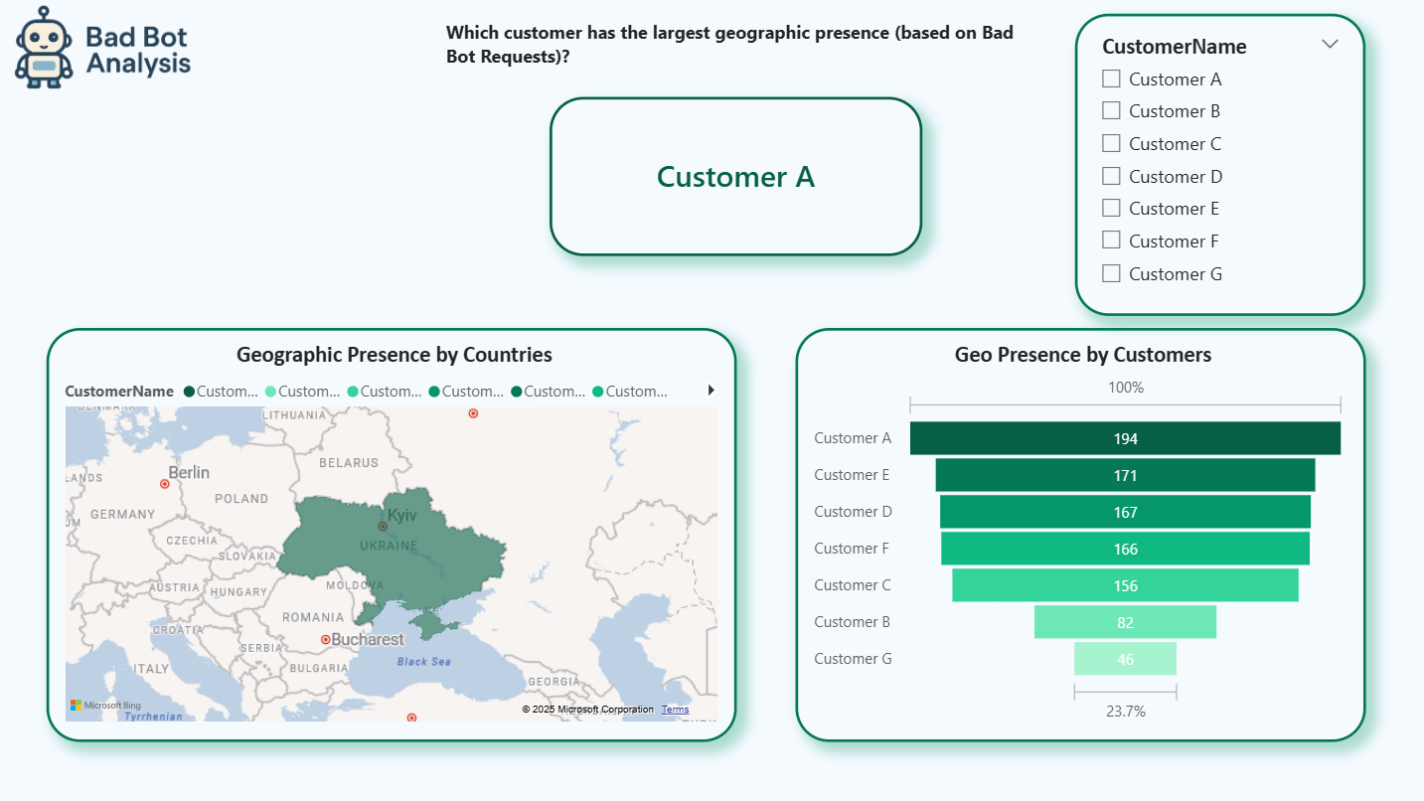
Requirement 1: Which customer has the largest geographic presence (based on Bad Bot Requests)?
The dashboard shows geographic distribution through both a map visualization highlighting Eastern European countries particularly Ukraine and a Funnel chart ranking all customers. Customer A significantly leads the other customers, followed by Customer E - 171 requests, Customer D - 167 requests, and Customer F - 166 requests. The remaining customers B, C, and G have considerably fewer bad bot requests, with Customer G having the smallest presence at just 46 requests.
The map visualization suggests that the bad bot activity is concentrated in the Eastern European region, with Ukraine appearing to be a primary source of these requests across the customer base.

Slide 3
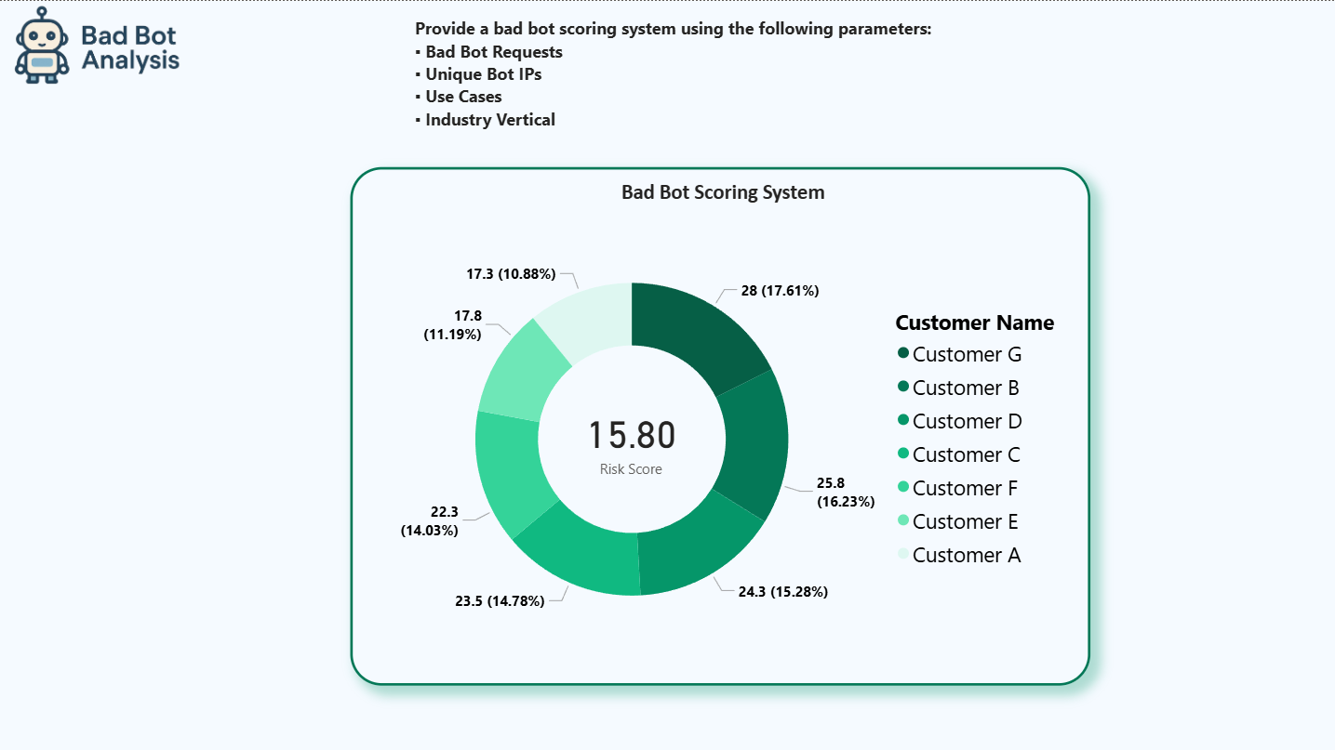
Requirement 2: Provide a bad bot scoring system using the following parameters: Bad Bot Requests ,Unique Bot IPs, Use Cases ,Industry Vertical.
This Power BI visual shows a Bad Bot Risk Score of 15.80, based on Bad Bot Requests, Unique Bot IPs, Use Cases, and Industry Vertical.
Customer G has the highest risk (28, 17.61%), followed by B (25.8, 16.23%) and D (24.3, 15.28%). Customer A, despite the largest geographic presence, has the lowest risk. Customers C, F, and E show moderate risk (10–15%).
The scoring provides a comprehensive view of bot threats beyond just request volume.

Slide 4
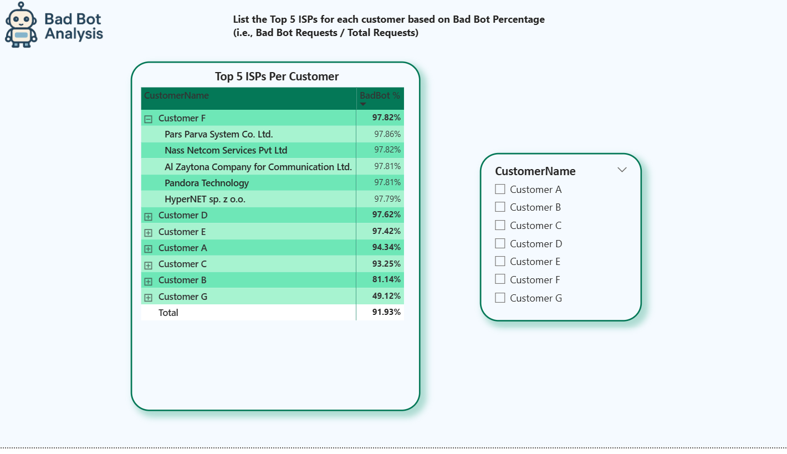
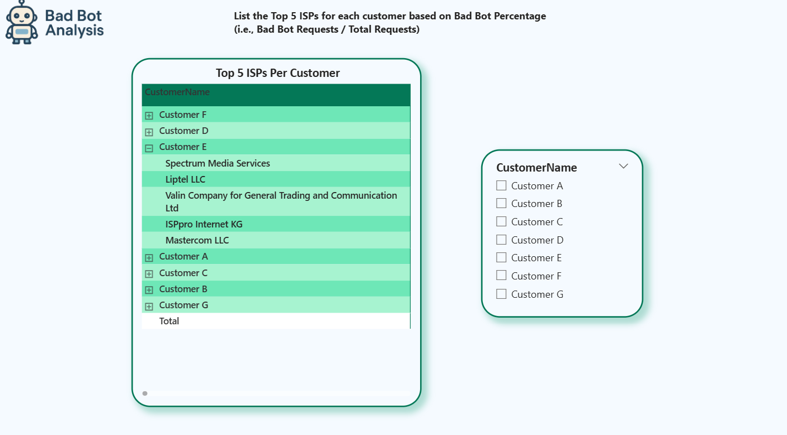
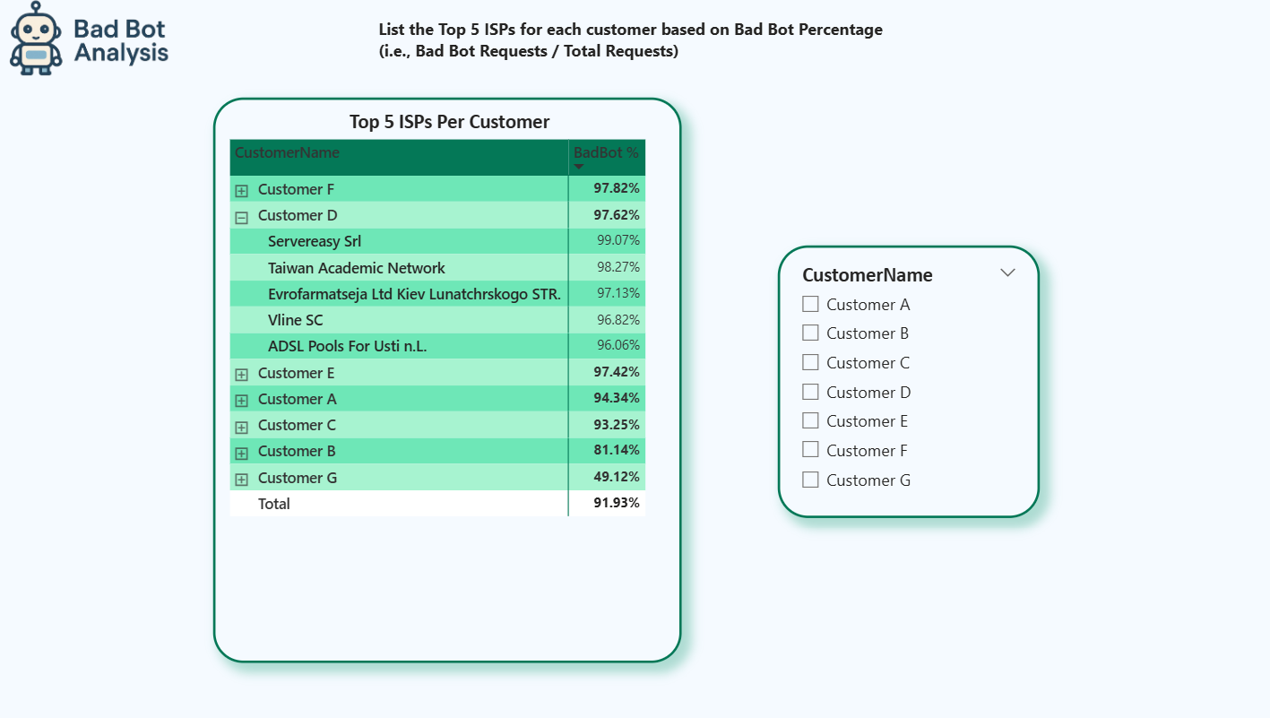
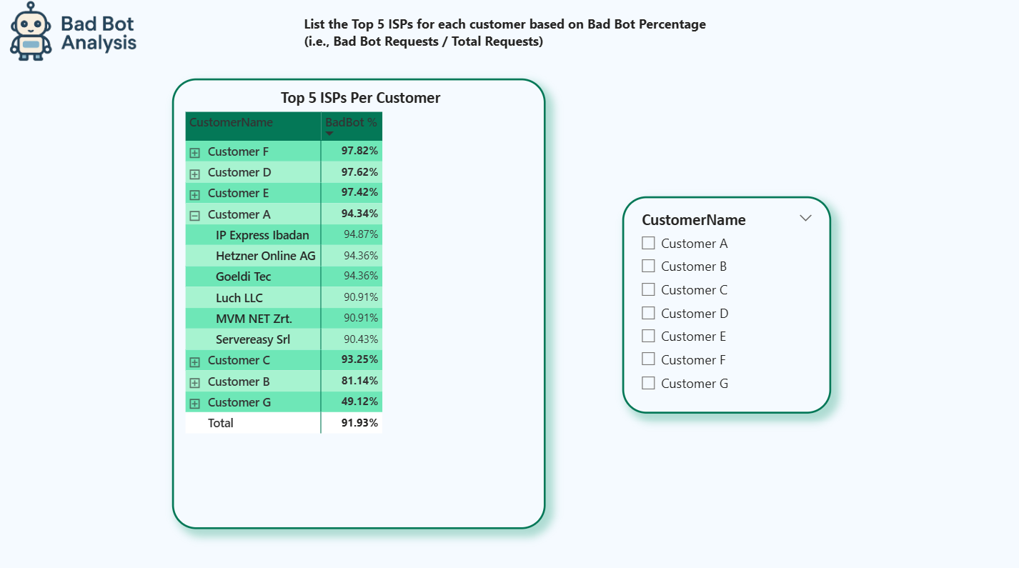
Requirement 3: List the Top 5 ISPs for each customer based on Bad Bot Percentage

Slide 5
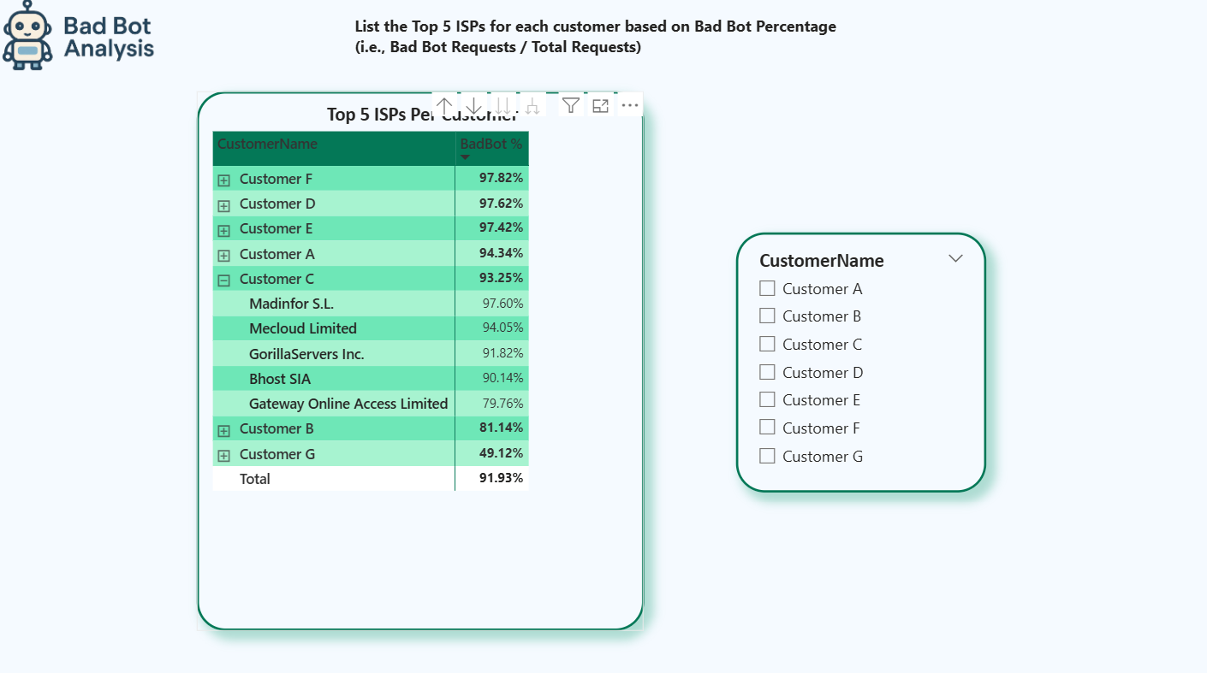
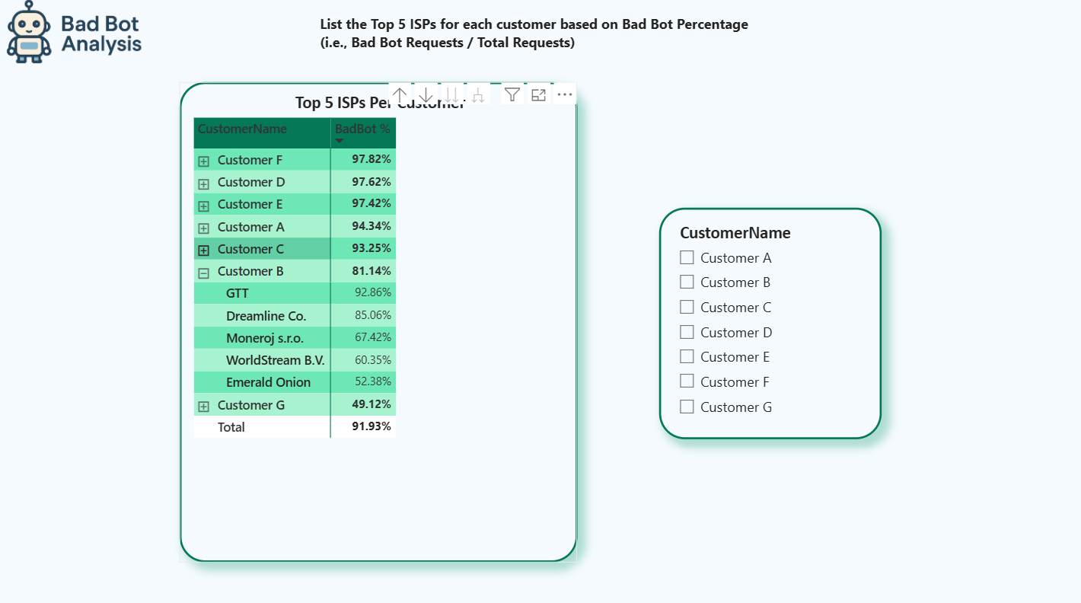
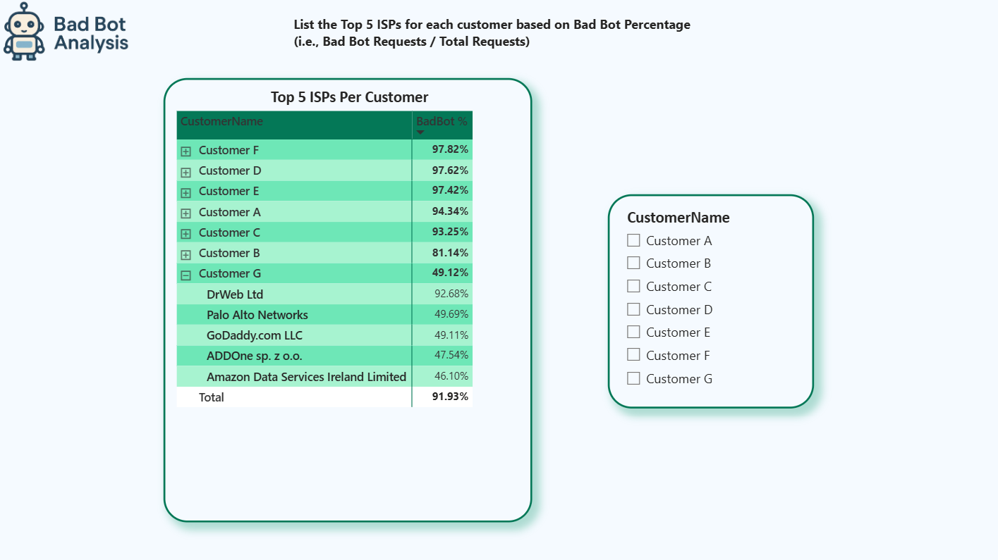
Requirement 3: List the Top 5 ISPs for each customer based on Bad Bot Percentage

Slide 6
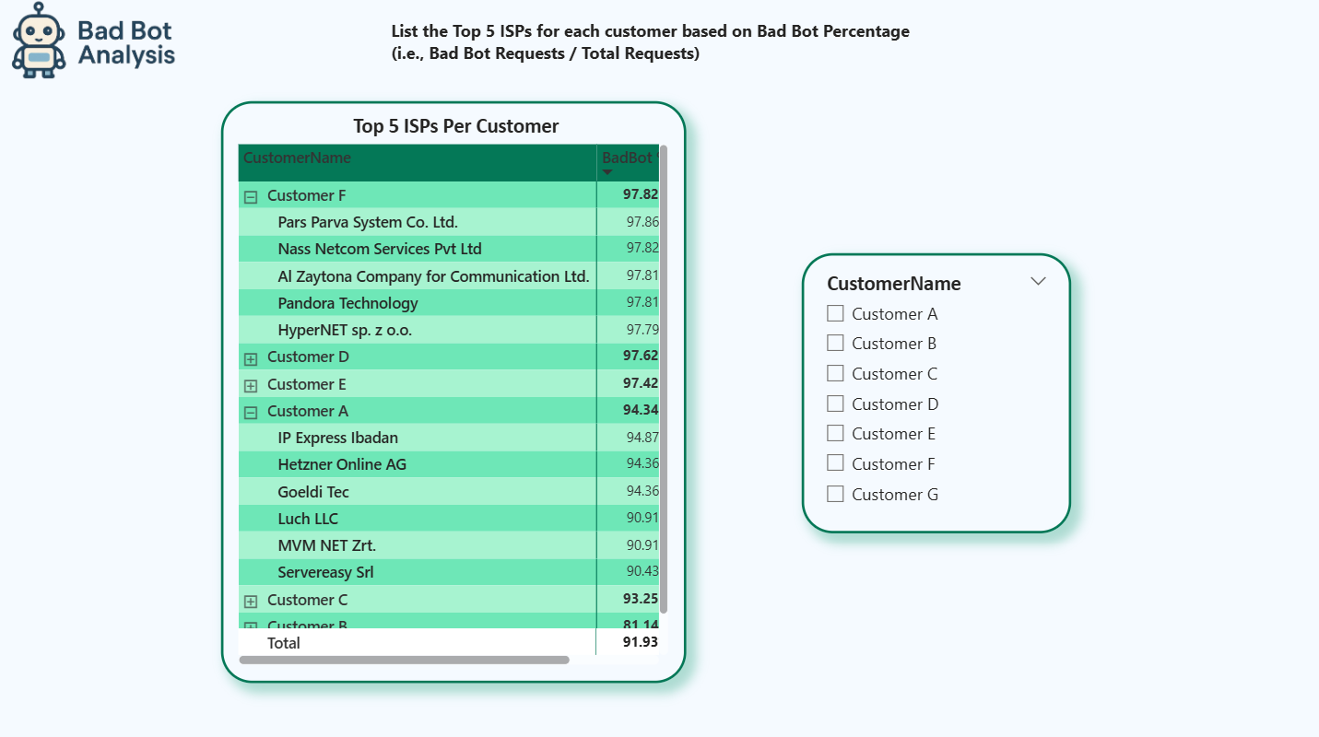
Requirement 3: List the Top 5 ISPs for each customer based on Bad Bot Percentage
This Power BI chart highlights the Top 5 ISPs per customer by Bad Bot Percentage, revealing extremely high bot traffic across the board.
Customer F leads with ISP rates above 97.79%, peaking at 97.86%.
Customers D, E, C also show over 93% from their top ISPs.
Customer A, though slightly lower, still has ISPs with 90–95% bot traffic.
The overall average bad bot rate is 91.93%, pointing to widespread bot activity and likely compromised ISPs or bot farms.

Slide 7
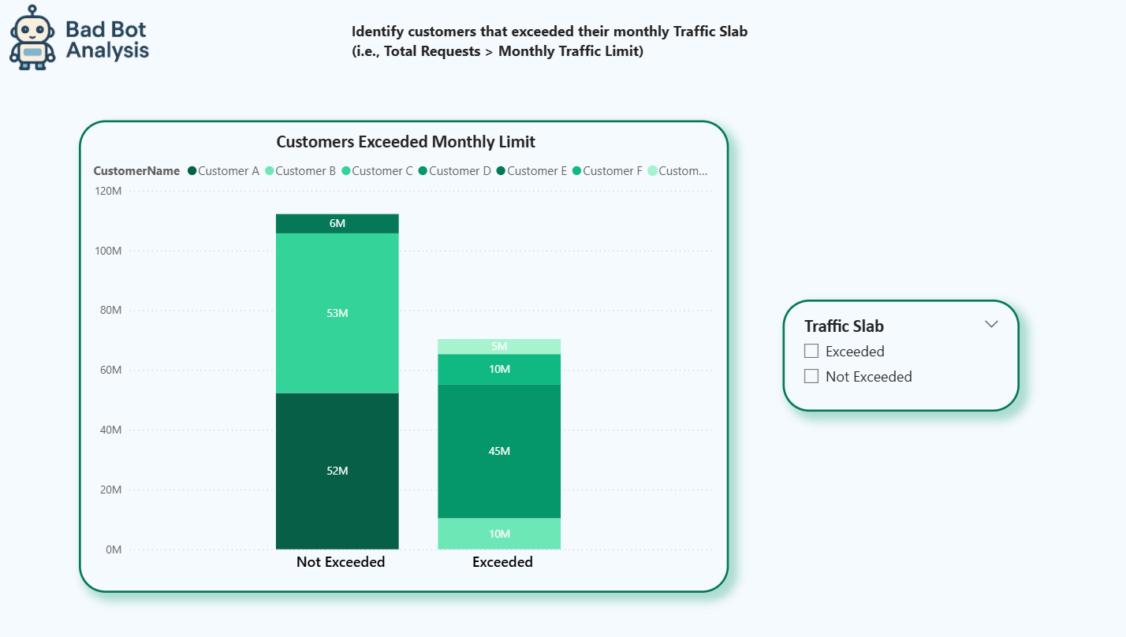
Requirement 4: Identify customers that exceeded their monthly Traffic Slab
This Power BI visualization identifies customers that exceeded their monthly traffic limits by comparing total requests against monthly traffic slabs.
4 of 7 customers exceeded their limits:
Customer D (45M), E (10M), F (10M), G (5M)
Total exceeded traffic: 70M requests
Customers within limits:
A (52M), B (53M), C (6M)
Total compliant traffic: 111M requests
Customer D had the largest overage, indicating potential bot spikes or misaligned traffic slabs.

Slide 8
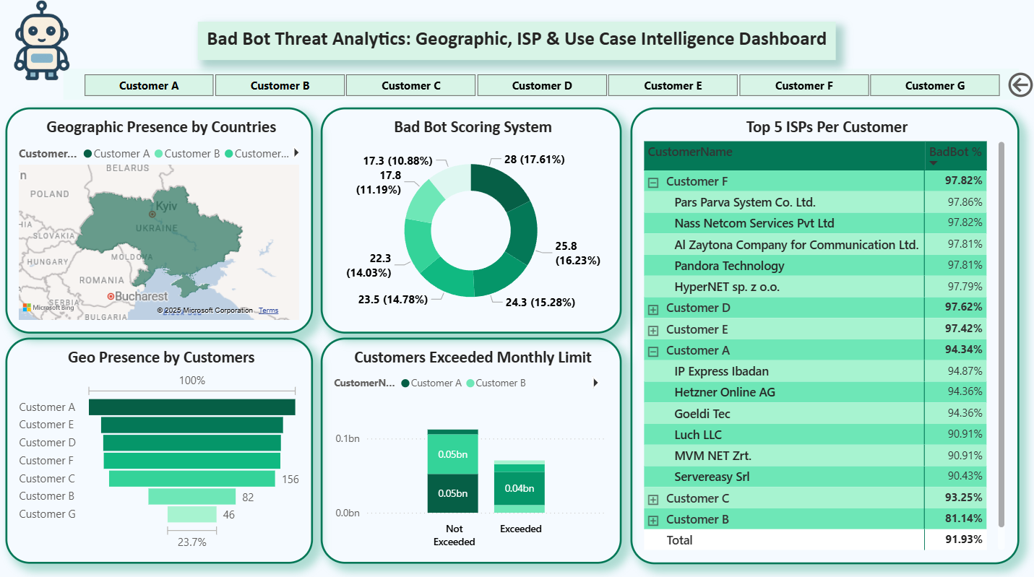
MAIN DASHBOARD

Slide 9
MAIN DASHBOARD SUMMARY
This Bad Bot Threat Analytics Dashboard provides a comprehensive view of bot threats across geographic, ISP, and customer dimensions with several critical findings:
Key Insights:
Geographic Distribution: Bad bot activity is heavily concentrated in Eastern Europe, particularly Ukraine, with Customer A having the largest geographic footprint (194 requests, 23.7% of total).
Risk Assessment: The scoring system shows a 15.80 overall risk score, with Customer G posing the highest individual risk (28, 17.61%) despite having lower request volumes, indicating the system considers multiple threat factors beyond just volume.
ISP Analysis: Reveals an alarming 91.93% overall bad bot percentage across all traffic, with certain ISPs showing extremely high bot rates.
Customer F's ISPs: 97.82-97.86% bot traffic
Customer D: 97.62% bot traffic
Multiple ISPs consistently above 90% bot traffic
Traffic Compliance: 4 out of 7 customers exceeded their monthly traffic limits, with significant violations particularly from Customer D (45M requests) and others ranging from 5-10M excess requests.
Critical Concerns:
Severe bot infiltration with over 90% of traffic being malicious
Geographic concentration suggesting coordinated attacks from specific regions
Traffic limit violations indicating potential bot-driven traffic spikes
High-risk ISPs that appear to be compromised or hosting bot farms
This dashboard indicates a critical security situation requiring immediate attention to bot mitigation strategies, ISP monitoring, and traffic management policies.

Slide 10
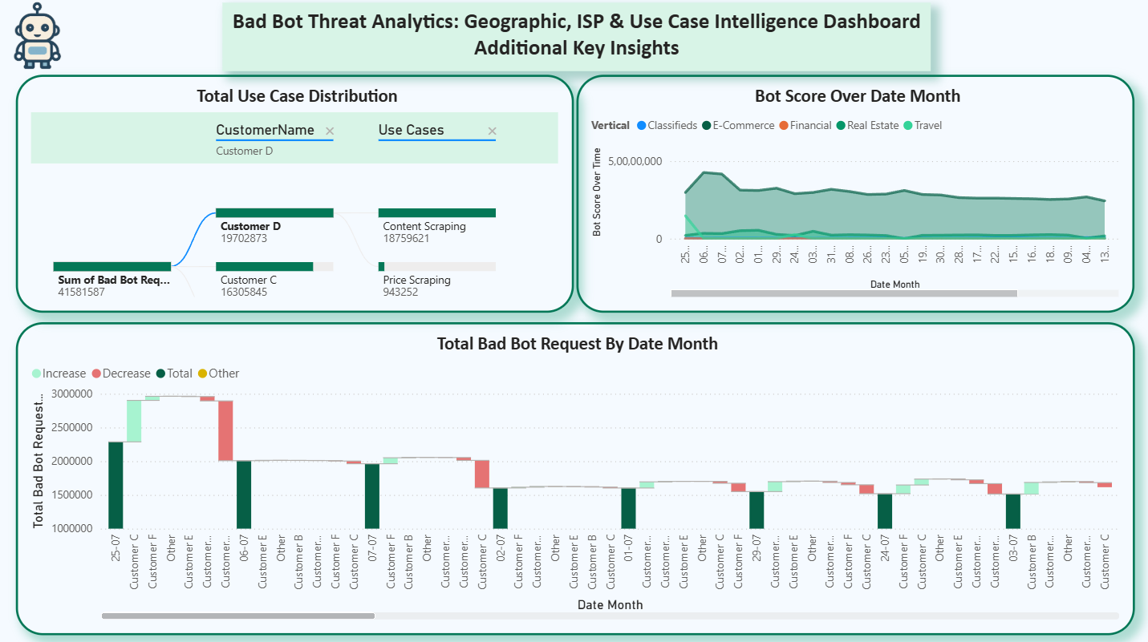
ADDITIONAL INSIGHTS

Slide 11
ADDITIONAL INSIGHTS SUMMARY
This dashboard provides deeper temporal, use-case, and industry-level analysis of the evolving bad bot threat landscape.
Key Insights:
Use Case Analysis:
Customer D leads with 19.7M bad bot requests, primarily for content scraping (18.7M), while Customer C follows with 16.3M focused on price scraping (943K).
Content and price scraping are the dominant vectors, pointing to commercial data theft across customers.
A total of 41.5M bad bot requests were recorded, underscoring the scale of these targeted scraping attacks.
Industry Vertical Trends:
Travel and Real Estate sectors are the most affected, showing consistently high bot activity.
E-Commerce and Financial sectors face moderate but persistent threats, while Classifieds remains steadily targeted at lower volumes.
Bot scores across industries remain stable around the 5M mark, indicating ongoing activity across verticals.
Temporal Pattern Analysis:
Bot activity shows significant volatility, with spikes reaching 3M requests during peak periods.
The data reflects cyclical patterns—bursts of high-volume attacks followed by quieter intervals.
Recent months have maintained elevated threat levels (1.5M–2M requests), signaling sustained campaigns.
The seasonality in attacks points to coordinated, large-scale bot operations.
Critical Concerns:
Content scraping is the leading threat, suggesting intellectual property theft is a primary motive.
Multi-industry targeting reveals sophisticated, adaptable bot strategies.
Persistent, organized bot campaigns dominate, ruling out isolated or accidental activity.
Customer D emerges as the highest-risk entity, with nearly 20M malicious requests aimed at data extraction.

Slide 12
CONCLUSION
The analysis uncovers a severe bot-driven cyber threat, with 91.93% of traffic being malicious and 41.5M bad bot requests across customers. The attacks are highly coordinated, targeting multiple industries through content and price scraping, compromised ISPs, and Eastern European origins.
With 4 out of 7 customers exceeding traffic limits and Customer D facing the highest risk, the threat poses serious risks to data security, infrastructure stability, and business continuity. Immediate bot mitigation, ISP blacklisting, and long-term security enhancements are critical to countering this large-scale, organized cyberattack.

